Slide 1
All About Unit Testing
Presented by QC Coders

Slide 2
What Is Unit Testing?
UNIT TESTING is a level of software testing where individual units/ components of a software are tested.
The purpose is to validate that each unit of the software performs as designed.
A unit is the smallest testable part of any software. It usually has one or a few inputs and usually a single output.
In procedural programming, a unit may be an individual program, function, procedure, etc.
In object-oriented programming, the smallest unit is a method, which may belong to a base/ super class, abstract class or derived/ child class.
http://softwaretestingfundamentals.com/unit-testing/

Slide 3
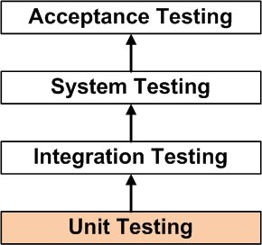
What About Other Types of Testing?

Slide 4
What About Other Types of Testing?
Unit Testing
Tests the smallest testable parts of software
Primary audience: developers
Integration Testing
Tests two or more units
Primary audience: senior/lead developers
System Testing
Tests whether the integrated software works together
Primary audience: leads, architects, business analysts
Acceptance Testing
Tests whether the software system as a whole meets business requirements
Primary audience: stakeholders, product owner

Slide 5
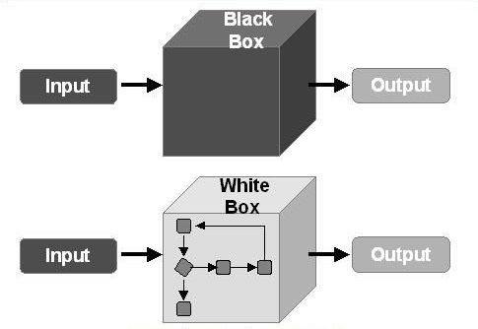
What Methods Can We Use to Unit Test?

Slide 6
Questions?

